Slide 1
Mathematical methods for Image Synthesis
Nicolas Bonneel Julie Digne

Slide 2
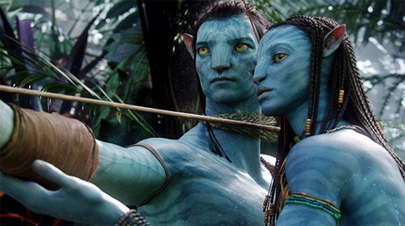
Color Grading
Textures
Geometry
Lighting simulation

Slide 3
Optimal Transport Image Processing
Texture Synthesis Parameterization
Spectral mesh
processing
Monte-Carlo Simulation Materials description

Slide 4
Monte-Carlo methods for 3d rendering

Slide 5
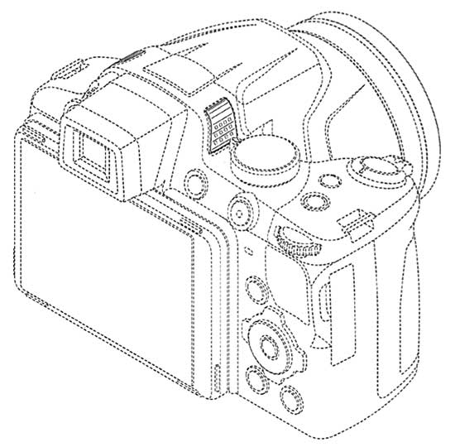
Projection
Rasterization
(OpenGL, DirectX)
Raytracing
(physically-based rendering)

Slide 6
x
x
x
x
x
x
x
x
x
x
x
x
x
x
x
x
x
x
x
x
x
x
x
x
x
x
x
x
x
x
x
x
x
x
x
x
x
x
x
x
x
x
x
x
x
x
x
x
x
x
x
x
x
x
x
x
x
x
x
x
x
x
x
x
x
x
x
x
x
x
x
x
x
x
x
x
x
x
x
x
x
x
x
x
x
x
x
x
x
x
x
x
Rasterization
(OpenGL, DirectX)
Raytracing
(physically-based rendering)

Slide 7
procedure drawTriangle(T)
T’ = Project(T)
Rect = bounding_box(T’)
For each pixel p in Rect
If p inside T’
If depth(p) < z_buffer(p)
p = color
z_buffer(p) = depth(p)
End if
End if
End For
End Procedure
Rasterization
(OpenGL, DirectX)
Raytracing
(physically-based rendering)

Slide 8
procedure drawTriangle(T)
T’ = Project(T)
Rect = bounding_box(T’)
for each pixel p in Rect
if p inside T’
if depth(p) < z_buffer(p)
p = color
z_buffer(p) = depth(p)
End procedure
procedure drawPixel(p)
L = Line(origin, p)
S = ∅
for each primitive T
S = S ∪ intersect(L, T)
S = sort(S)
if S ≠ ∅
p = color
End Procedure
Rasterization
(OpenGL, DirectX)
Raytracing
(physically-based rendering)

Slide 9
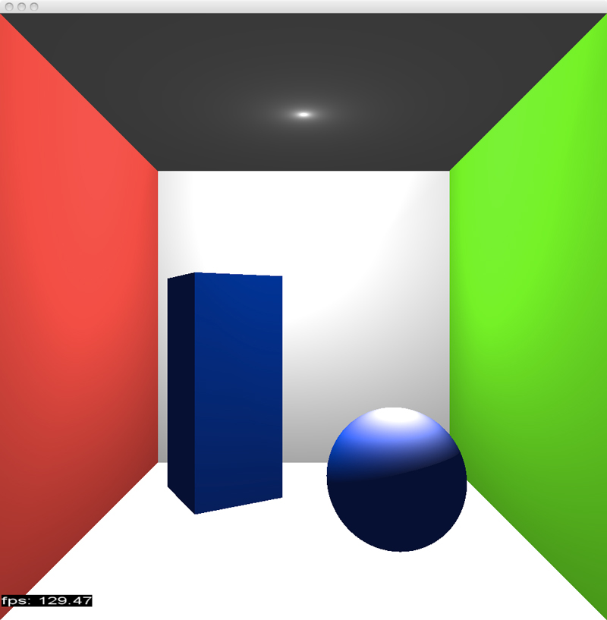
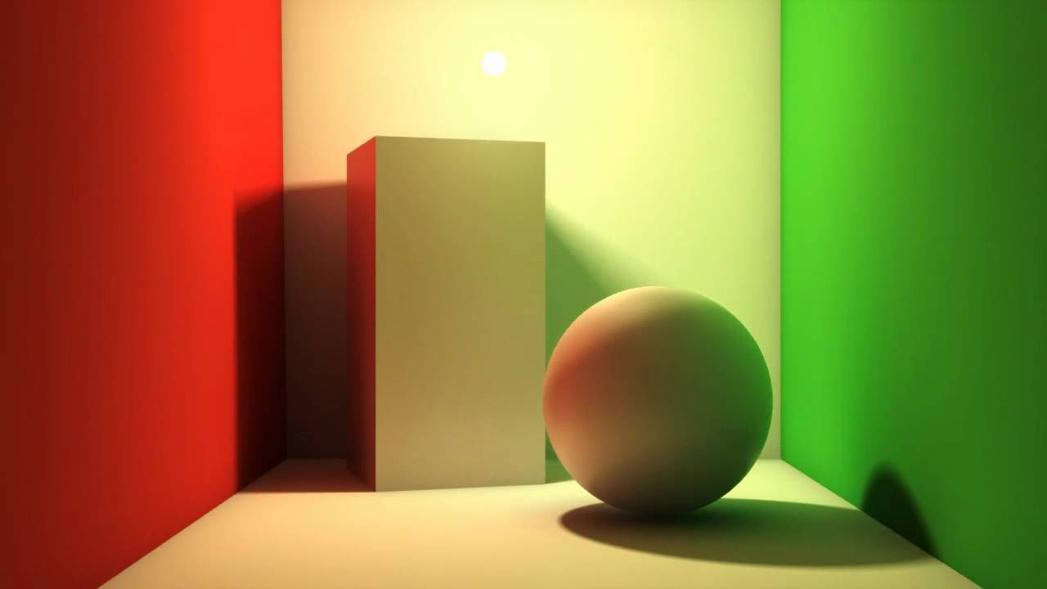
Rasterization
(OpenGL, DirectX)
Raytracing
(physically-based rendering)

Slide 10
Why realism can be important ?
Uncanny Valley

Slide 11
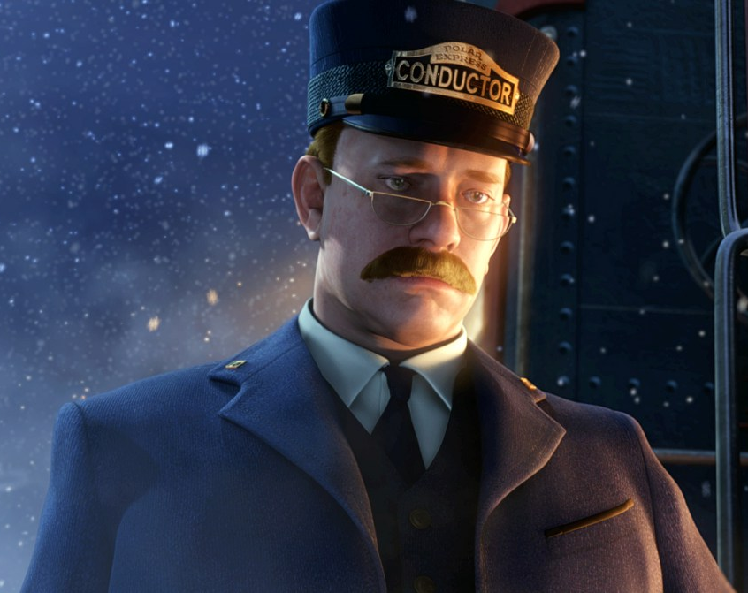
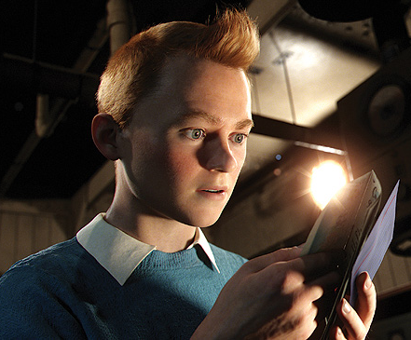
Uncanny Valley
Polar Express
Tintin

Slide 12
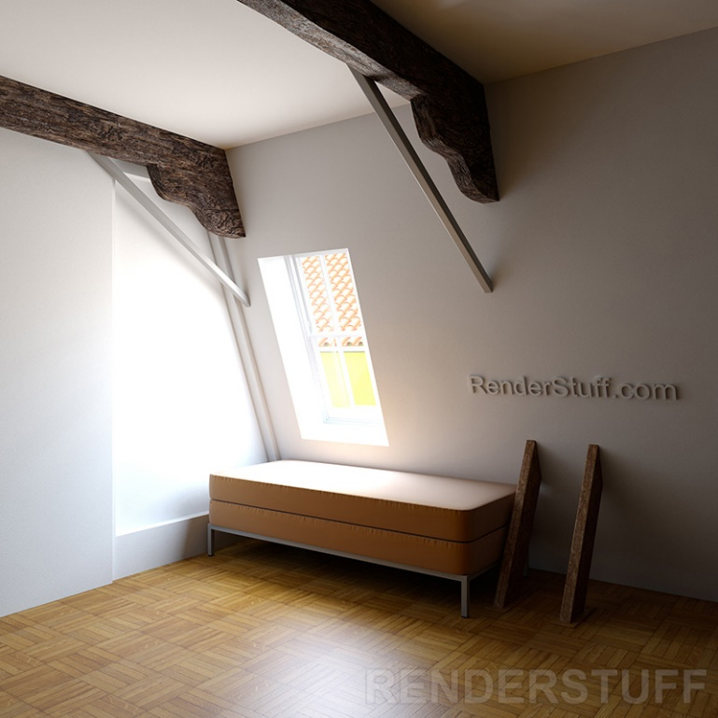
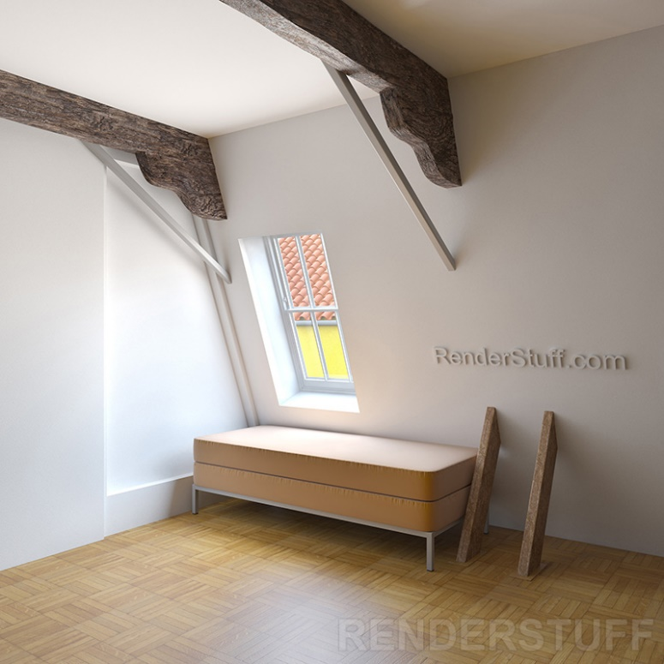
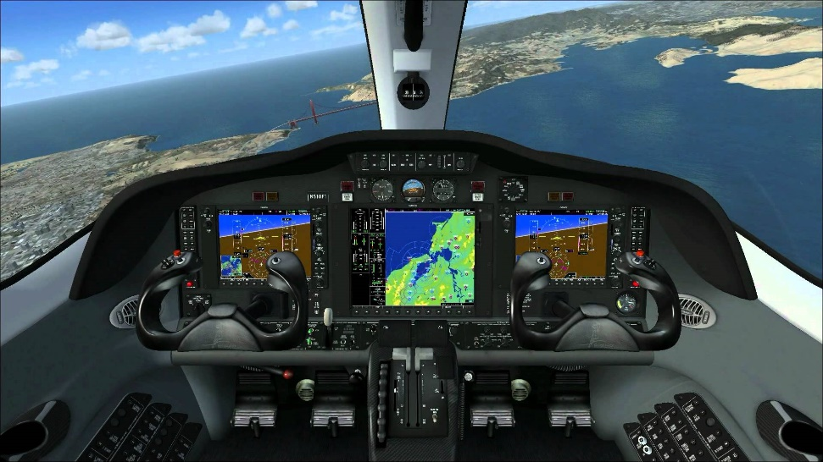
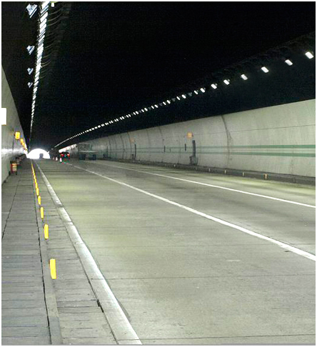
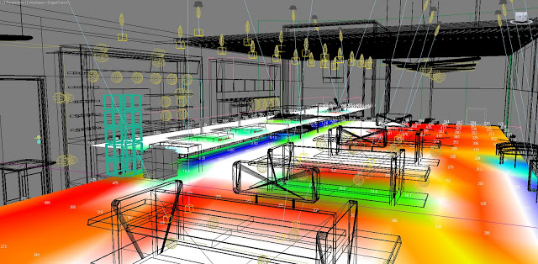
What is realism ?
Physical Realism - full simulation - useful in scientific computing - e.g., architecture
Photo-realism - motivated by perception - HDR, faster rendering
Functional Realism
“Three Varieties of Realism in Computer Graphics”, Ferwerda

Slide 13
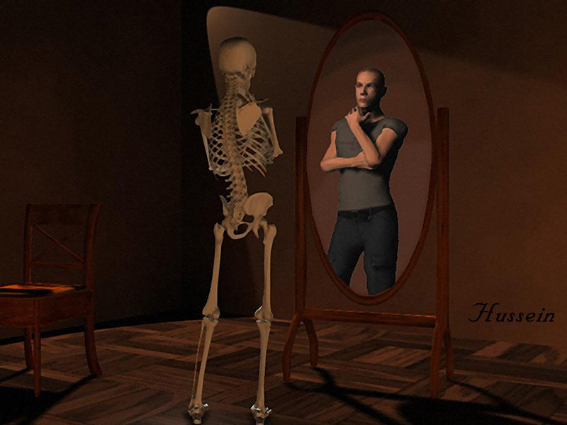
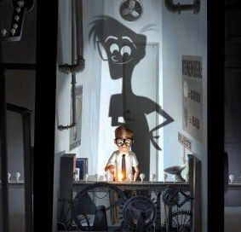
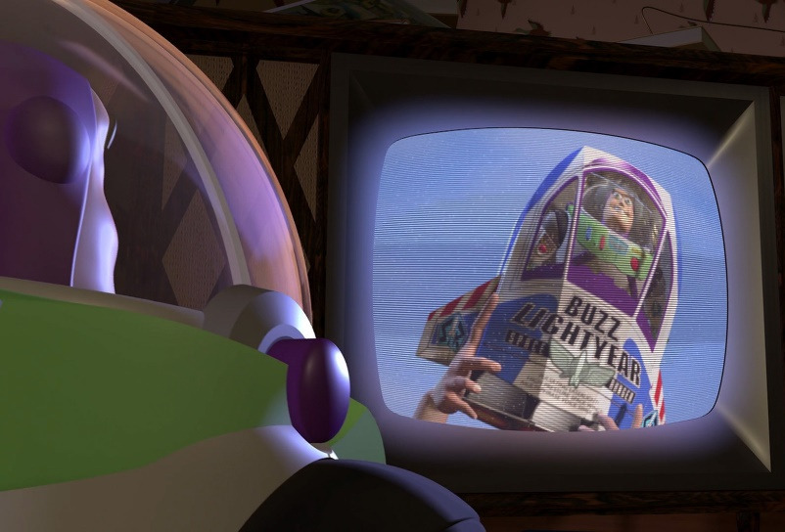
Limits of realism
Non-Photorealistic Rendering
Non physically realistic
Non realistic

Slide 14
The rendering equation

Slide 15
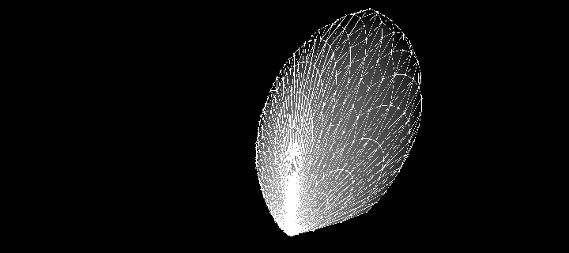
Bidirectional Reflectance Distribution Functions (BRDF)
*
Function $f :S^{2} ×S^{2} (×ℝ)→ℝ$
Describes the appearance of materials
Such that:
$f\left(ω_{i}, ω_{o}\right)=f\left(ω_{o}, ω_{i}\right)$ (Helmoltz’s reciprocity)
$f\left(ω_{i}, ω_{o}\right)≥0$
$\int_{Ω}{f\left(ω_{i}, ω_{o}\right) ω_{i}^{y}dω_{i}≤1}$
$$ω_{i}$$

Slide 16
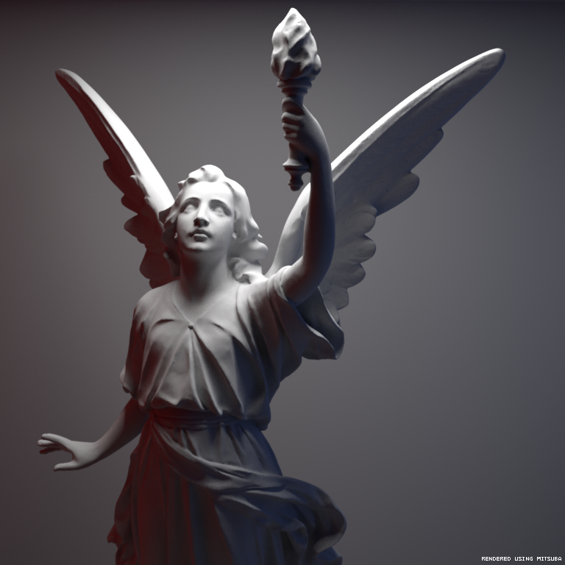
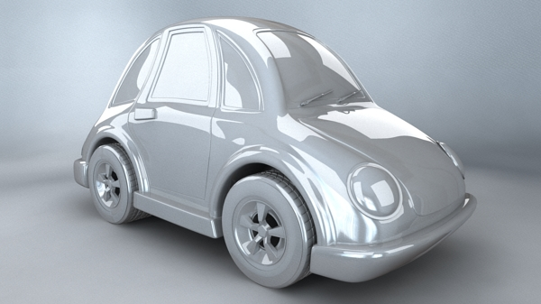
Bidirectional Reflectance Distribution Functions (BRDF)
Specular BRDF.
$$f\left(ω_{i}, ω_{o}\right)=δ(R−ω_{o})$$
Diffuse (Lambertian) BRDF.
$$f\left(ω_{i}, ω_{o}\right)=\frac{ρ}{π}$$

Slide 17
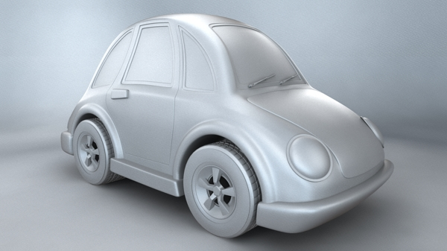
Bidirectional Reflectance Distribution Functions (BRDF)
Glossy BRDF
$f\left(ω_{i}, ω_{o}\right)=…$ many options

Slide 18
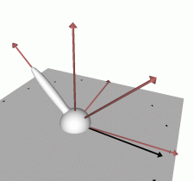
Bidirectional Reflectance Distribution Functions (BRDF)
*
$$\vec{n}$$
Analytical models
Phenomenological/Experimental models :
Phong $f\left(ω_{i}, ω_{o}\right)=\left\langle ω_{o}\right.,{\left.R\right\rangle }^{α}$
Blinn $f\left(ω_{i}, ω_{o}\right)=\left\langle \vec{n}\right.,{\left.H\right\rangle }^{α}$
Ward $f\left(ω_{i}, ω_{o}\right)={\exp\left( −\tan^{2}{\frac{\left\langle \vec{n}, H⟩\right.}{α^{2}}}\right)}/{4πα^{2}\sqrt{\left\langle \vec{n}, ω_{o}⟩\right.\left\langle \vec{n}, ω_{i}⟩\right.}}$
Lafortune, Minnaert, Strauss, Lewis, Schlick, ....
$$R$$
$$H$$
$$ω_{i}$$
$$ω_{o}$$
Phong

Slide 19
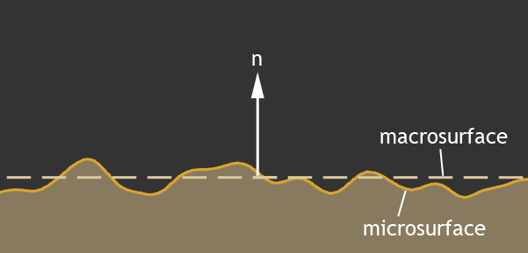
Bidirectional Reflectance Distribution Functions (BRDF)
Distribution of normals (~Gaussian)
Shadowing and masking
(can be related to D)
Analytical models
Physical models (microfacets):
Ashikhmin-Shirley
Cook-Torrance
Poulin-Fournier, Torrance-Sparrow, Oren-Nayar, Kajiya, ...
Fresnel
$$f\left(ω_{i}, ω_{o}\right)=\frac{F\left(β\right)}{π}\frac{D\left(H\right)G(ω_{i},ω_{o}) }{\cos\left(ω_{o}\right) cos⁡(ω_{i})}$$
Cook-Torrance
Poulin Fournier

Slide 20
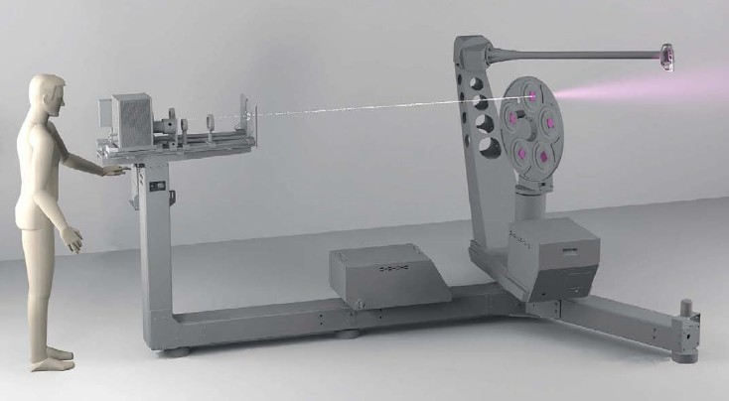
Bidirectional Reflectance Distribution Functions (BRDF)
Empirical models

Slide 21
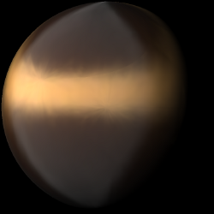
Bidirectional Reflectance Distribution Functions
Empirical models

Slide 22
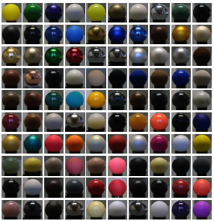
Bidirectional Reflectance Distribution Functions

Slide 23
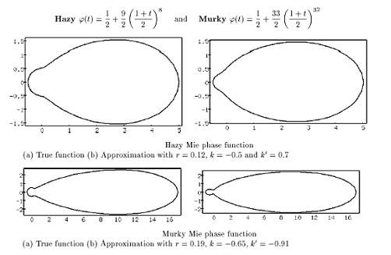
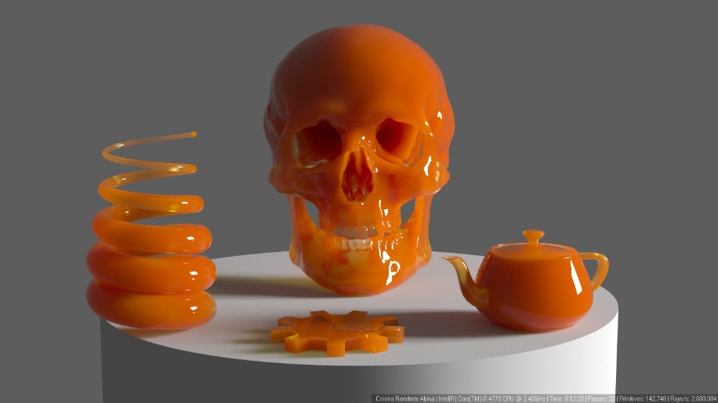
Bidirectional Reflectance Distribution Functions (BRDF)
Other / generalizations
BSDF
Scattering / Phase functions
BSSRDF
SVBRDF

Slide 24
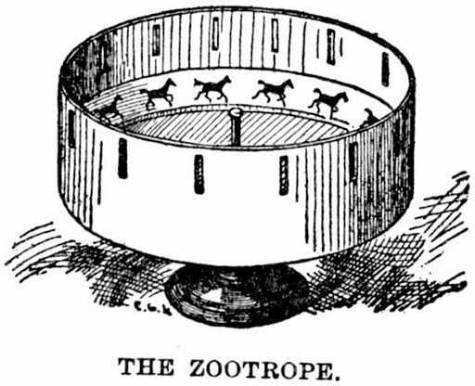
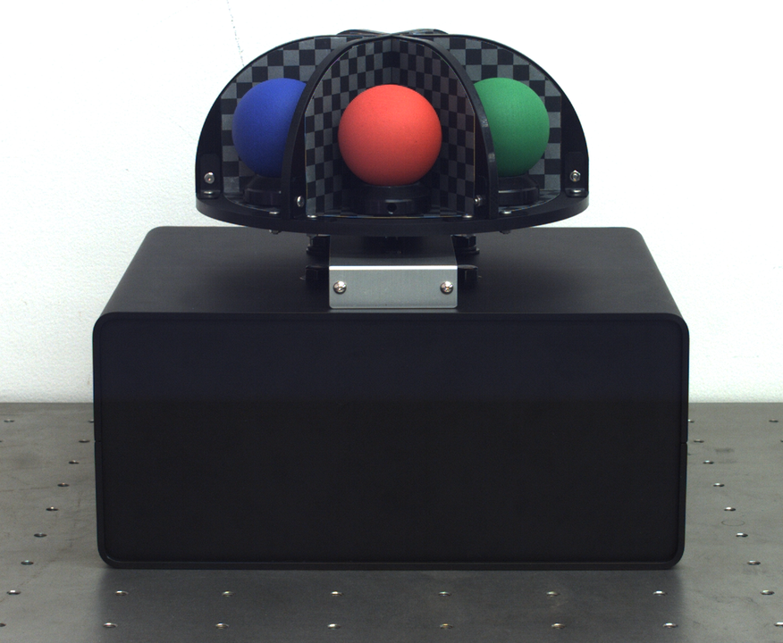
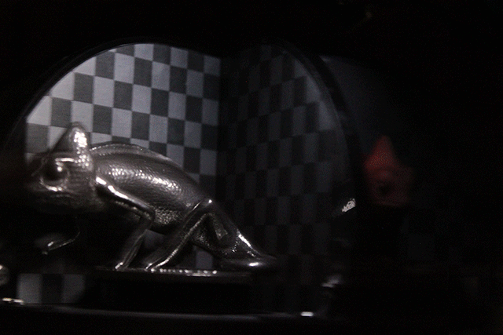
Bidirectional Reflectance Distribution Functions (BRDF)
Parenthesis: BRDF printing
Zoematrope
L. Miyashita, K. Ishihara, Y. Watanabe and M. Ishikawa
ZoeMatrope: A System for Physical Material Design (SIGGRAPH 2016)

Slide 25
The rendering equation
$$L_{o}\left(x, \vec{ω_{o}}\right)=L_{e}\left(x,\vec{ω_{o}}\right)+\int_{Ω}{f\left(\vec{ω_{i}}, \vec{ω_{o}}\right)L_{i}\left(x,\vec{ω_{i}}\right)\left\langle \vec{ω_{i}}\right.,\left.\vec{n}\right\rangle d\vec{ω_{i}}}$$
Assumptions:
Geometric optics
No subsurface scattering, fluorescence, transparency, polarization
*
$$L_{i}$$
$$\vec{ω_{i}}$$
$$\vec{n}$$
$$L_{o}$$
$$\vec{ω_{o}}$$
$L_{e}$ (?)

Slide 26
The rendering equation
$$L_{o}\left(x, \vec{ω_{o}}\right)=L_{e}\left(x,\vec{ω_{o}}\right)+\int_{Ω}{f\left(\vec{ω_{i}}, \vec{ω_{o}}\right)L_{i}\left(x,\vec{ω_{i}}\right)\left\langle \vec{ω_{i}}\right.,\left.\vec{n}\right\rangle d\vec{ω_{i}}}$$
*
*
*
$$\vec{n}$$

Slide 27
The rendering equation
$$L_{o}\left(x, \vec{ω_{o}}\right)=L_{e}\left(x,\vec{ω_{o}}\right)+\int_{Ω}{f\left(\vec{ω_{i}}, \vec{ω_{o}}\right)L_{i}\left(x,\vec{ω_{i}}\right)\left\langle \vec{ω_{i}}\right.,\left.\vec{n}\right\rangle d\vec{ω_{i}}}$$
*
*
*
$$\vec{n}$$

Slide 28
The rendering equation
$$L_{o}\left(x, \vec{ω_{o}}\right)=L_{e}\left(x,\vec{ω_{o}}\right)+\int_{Ω}{f\left(\vec{ω_{i}}, \vec{ω_{o}}\right)L_{i}\left(x,\vec{ω_{i}}\right)\left\langle \vec{ω_{i}}\right.,\left.\vec{n}\right\rangle d\vec{ω_{i}}}$$
*
*
*
$$\vec{n}$$

Slide 29
The rendering equation

Slide 30
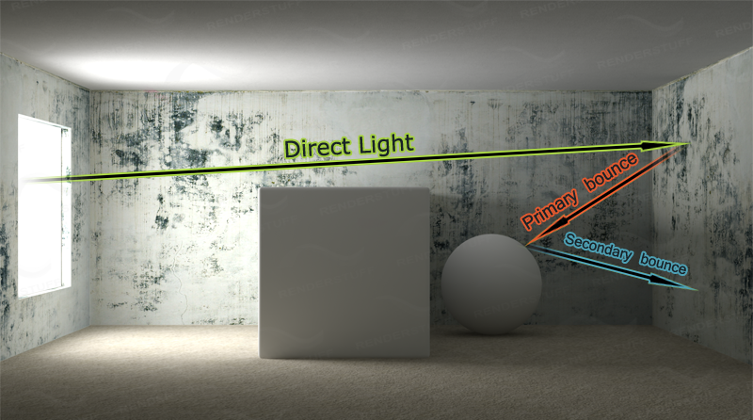
The rendering equation

Slide 31
First idea: Using Helmoltz’s reciprocity
*
*
*
$$\vec{n}$$
Idea behind Backward Raytracing / path tracing

Slide 32
The rendering equation
$$L_{o}\left(x, \vec{ω_{o}}\right)=L_{e}\left(x,\vec{ω_{o}}\right)+\int_{Ω}{f\left(\vec{ω_{i}}, \vec{ω_{o}}\right)L_{i}\left(x,\vec{ω_{i}}\right)\left\langle \vec{ω_{i}}\right.,\left.\vec{n}\right\rangle d\vec{ω_{i}}}$$
At each bounce, new integral
$$L_{o}\left(x, \vec{ω_{o}}\right)=L_{e}\left(x,\vec{ω_{o}}\right)+\int_{Ω}{f\left(\vec{ω_{i}}, \vec{ω_{o}}\right)\left[L_{e}\left(x^{′},\vec{ω_{i}}\right)+\int_{Ω}{f(\vec{ω_{i′}}, \vec{ω_{i}})L_{i}\left(x′,\vec{ω_{i′}}\right)}\left\langle \vec{ω_{i′}}\right.,\left.\vec{n′}\right\rangle d\vec{ω_{i′}}\right]}\left\langle \vec{ω_{i}}\right.,\left.\vec{n}\right\rangle d\vec{ω_{i}}$$
Fredholm equation of the second kind
$$\vec{ω_{i′}}$$
$$\vec{n′}$$
$$x′$$
$$\vec{ω_{i}}$$
$$\vec{n}$$
$$x$$
$$\vec{ω_{o}}$$

Slide 33
The rendering equation
$$L_{o}\left(x, \vec{ω_{o}}\right)=L_{e}\left(x,\vec{ω_{o}}\right)+\int_{Ω}{f\left(\vec{ω_{i}}, \vec{ω_{o}}\right)L_{i}\left(x,\vec{ω_{i}}\right)\left\langle \vec{ω_{i}}\right.,\left.\vec{n}\right\rangle d\vec{ω_{i}}}$$
At each bounce, new integral
$$L_{o}\left(x, \vec{ω_{o}}\right)=L_{e}+\int_{Ω}{\int_{Ω}{\int_{Ω}{\int_{Ω}{…\int_{Ω}{F\left(x, x^{′}, x^{′′}, x^{′′},..,x^{′′′′}, ω_{i}, ω_{i}^{′}, …,ω_{i}^{′′′′}, ω_{o}, ω_{o}^{′}, …, ω_{o}^{′′′′}\right)dωdω^{′}…dω′′′′}}}}}$$
$$\vec{ω_{i′}}$$
$$\vec{n′}$$
$$x′$$
$$\vec{ω_{i}}$$
$$\vec{n}$$
$$x$$
$$\vec{ω_{o}}$$

Slide 34
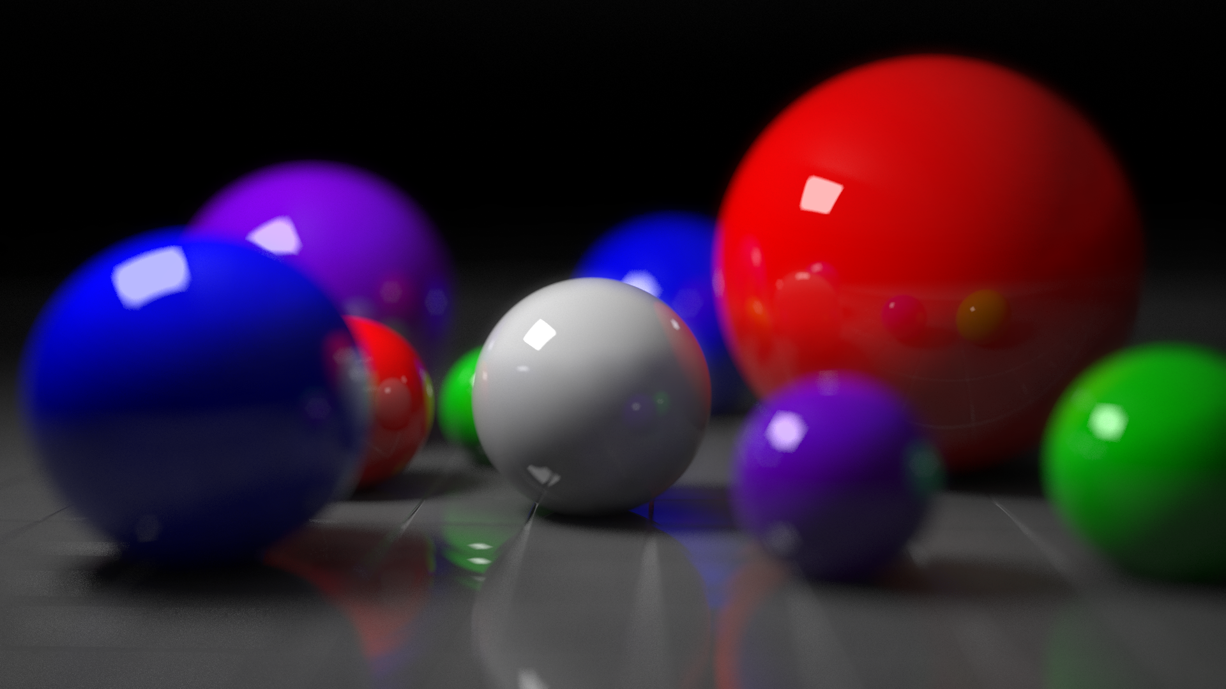
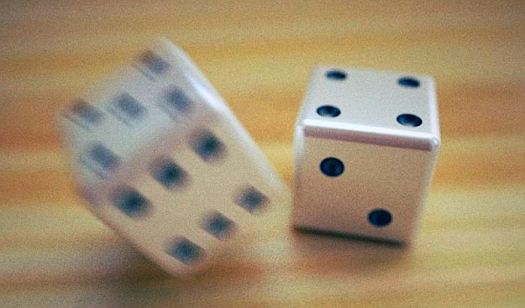
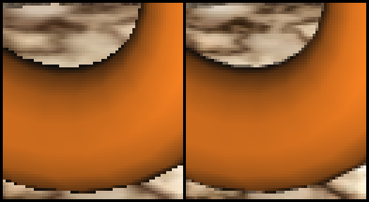
The rendering equation
In fact, additional dimensions for the camera model
Anti-Aliasing (+2D)
Depth-of-Field (+2D)
Motion blur (+1D)
Multispectral (+1D)

Slide 35
Second idea: integration
Method of rectangles, error in 1/N ($1/N^{2}$ for mid-point method – and better schemes exist)

Slide 36
Second idea: integration
In 2D:
In 3D:

Slide 37
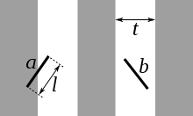
Second idea: integration
Instead, Monte-Carlo integration
Example: Buffon’s needle to estimate Pi
Probability for a needle to cross a line: $P= \frac{2l}{tπ}$
So, $π=\frac{2l}{tP}$

Slide 38
Monte-Carlo Integration
Why not using uniform random variables ?
x
x
x
x
x
x
x
x
x
x
x
x
Problem for specular or glossy BRDFs

Slide 39
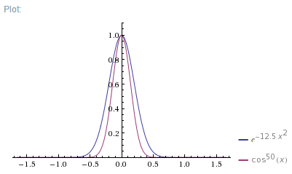
Monte-Carlo Integration
General formula:
$$\int{f\left(x\right)dx}≈\frac{1}{N}\sum_{i=1}^{N}{\frac{f\left(x_{i}\right)}{p\left(x_{i}\right)}}$$
Where $x_{i}\sim ℒ$
Example
$$\int_{x=−\frac{π}{2}}^{+\frac{π}{2}}{\cos^{50}{x}dx≈\frac{1}{N}\sum_{i=1}^{N}{\frac{\cos^{50}{x_{i}}}{\frac{1}{σ\sqrt{2π}}\exp\left(−\frac{x_{i}^{2}}{2σ^{2}}\right)}}}$$
Where $x_{i}\sim 𝒩(0, σ^{2})$
$$σ=\frac{1}{5}$$

Slide 40
Monte Carlo Integration
Other example
$$\int_{x=−\frac{π}{2}}^{+\frac{π}{2}}{{\int_{y=−\frac{π}{2}}^{+\frac{π}{2}}{\int_{z=−\frac{π}{2}}^{+\frac{π}{2}}{\int_{w=−\frac{π}{2}}^{+\frac{π}{2}}{\cos^{50}{(x∗y∗z∗w)}}}}}^{}{dw dz dy dx}≈\frac{1}{N}\sum_{i=1}^{N}{\frac{\cos^{50}{{(x}_{i}∗y_{i}∗z_{i}∗w_{i})}}{\frac{1}{σ\sqrt{2π}}\exp\left(−\frac{{(x}_{i}^{2}+y_{i}^{2}+z_{i}^{2}+w_{i}^{2})}{2σ^{2}}\right)}}}$$
Where $x_{i}, y_{i},z_{i}, w_{i}\sim 𝒩(0, σ^{2})$
Unlike rectangle integration, STILL a single sum
Property
If $f\left(x\right)=α p(x)$, we have $\int{f\left(x\right)dx}≈\frac{1}{N}\sum_{i=1}^{N}{\frac{f\left(x_{i}\right)}{p\left(x_{i}\right)}}=\frac{1}{N}\sum_{i=1}^{N}{α}=α$ for all $N$
... So there is equality, and you can take a single sample: $N=1$, or even 0 sample!
...so $\int{f\left(x\right)dx}=α$
....but if you know $α$, this means you already knew how to integrate $f$
So this NEVER happens: you always have $p$ “similar” to $f$ but not equal

Slide 41
Sampling
Independent random sampling
Following material from:
Fourier Analysis of Numerical Integration in Monte Carlo Rendering: Theory and Practice Kartic Subr, Gurprit Singh, Wojciech Jarosz

Slide 42
Sampling
Independent random sampling

Slide 43
Sampling
Poisson Disk
Independent random sampling
Regular sampling
Jittered/stratified sampling
CCVT

Slide 44
Frequency analysis
Uniform sampling

Slide 45
Frequency analysis
Jittered sampling

Slide 46
Frequency analysis
Poisson Disk

Slide 47
Frequency analysis
CCVT

Slide 48
Monte Carlo Integration
Convergence rate : Depends on frequency of samples
Random: variance in $1/N$
Jitter : variance in $1/N^{1.5}$
Poisson Disk : variance in $1/N$
CCVT: variance in $1/N^{1.5}$
With $\text{error}= \sqrt{\text{variance}}$
So, using standard random numbers, 4x more samples for 2x accuracy

Slide 49
Third idea: Change of variables
$$L_{o}\left(x, \vec{ω_{o}}\right)=L_{e}\left(x,\vec{ω_{o}}\right)+\int_{Ω}{f\left(\vec{ω_{i}}, \vec{ω_{o}}\right)L_{i}\left(x,\vec{ω_{i}}\right)\left\langle \vec{ω_{i}}\right.,\left.\vec{n}\right\rangle d\vec{ω_{i}}}$$
$$L_{o}\left(x, \vec{ω_{o}}\right)=L_{e}\left(x,\vec{ω_{o}}\right)+\int_{P}{f\left(\vec{ω_{i}}, \vec{ω_{o}}\right)L_{i}\left(x,\vec{ω_{i}}\right)\left\langle \vec{ω_{i}}\right.,\left.\vec{n}\right\rangle \frac{V\left(x, x^{′}\right)\left|\left\langle \vec{ω_{i}}\right.,\left.\vec{n}′\right\rangle \right|}{{\left\|x−x^{′}\right\|}^{2}}dP}$$
$$⇔$$
$$\vec{n′}$$
$$x′$$
$$\vec{ω_{i}}$$
$$\vec{n}$$
$$\vec{ω_{o}}$$
$$x$$
$$V=0$$

Slide 50
Path Tracing
*
*
Random ray
*
Random ray
$$\vec{n}$$
Random ray

Slide 51
Path Tracing
How to generate a random ray
With a probability similar to BRDF ?
Mostly easy: for diffuse BRDFs and some BRDF models e.g., diffuse: $p\left(θ\right)=\frac{\cos{θ}}{π}$ and $\left(x,y,z\right)=\left(\cos{2πr_{1}}\sqrt{1−r_{2}},\sin{2 πr_{1}}\sqrt{1−r2}, \sqrt{r_{2}}\right)$
See Global Illumination Compendium (Philip Dutré)
With a probability similar to incoming Light ?
More difficult in general
Easy for point lights
Both ?
“Multiple Importance Sampling”

Slide 52
Bidirectional Path Tracing
*
$$\vec{n}$$

Slide 53
Metropolis-Hastings
*
$$\vec{n}$$

Slide 54
Metropolis-Hastings
Probability P of accepting a new path p’
$P=min⁡(1, \frac{π\left(p^{′}\right)}{π\left(p\right)})$
Results in a sequence of paths following the distribution $π$
Ideal when paths are hard to find
Specular paths
Refraction / caustics
Small holes letting light pass
A Simple and Robust Mutation Strategy for the Metropolis Light Transport

Slide 55
Photon mapping
x
x
*
x
x
x
x
x
x
Faster Photon Map Global Illumination, PH Christensen
(only non purely specular objects receive photons)

Slide 56
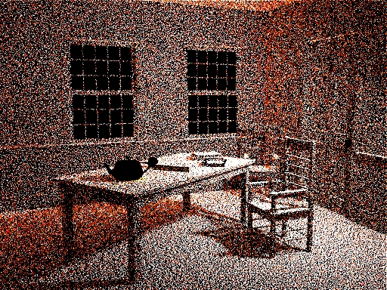
Photon mapping

Slide 57
Photon mapping
x
x
*
x
x
x
x
x
x
Final Gathering

Slide 58
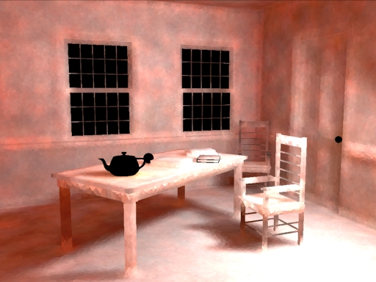
Photon mapping
Final gathering step (irradiance)

Slide 59
Photon mapping
Density estimation
Fix a radius, count the number of photons inside
Fix a number of photons to get, look at the radius
Goal: obtain a number of photon per unit area
Can weigh photons with distance
Bottleneck : Retrieving nearest neighbors
Acceleration structures (kd-trees, octrees...)
Biased estimate
For a finite # photons, the expected value is not the true value
Due to the gathering of nearby (and incorrect) values
E.g., next to a shadow, a pixel is systematically darker

Slide 60
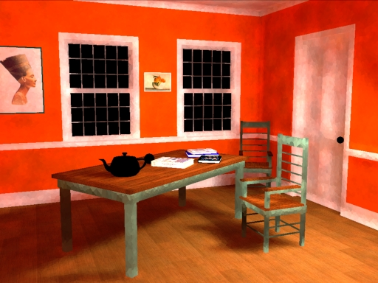
Photon mapping
Final gathering step (radiance)
Noisy. Idea:
do it just for indirect

Slide 61
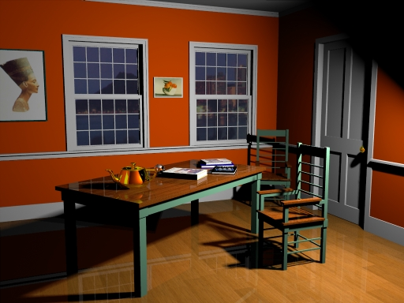
Photon mapping
Purely direct lighting

Slide 62
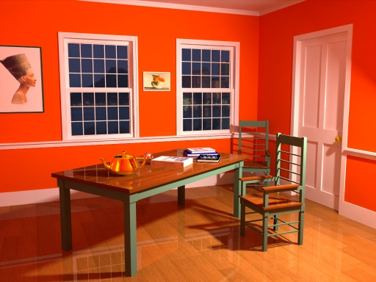
Photon mapping
Sum

Slide 63
Precomputed Radiance Transfer
$$L_{o}\left(x, \vec{ω_{o}}\right)=L_{e}\left(x,\vec{ω_{o}}\right)+\int_{Ω}{f\left(\vec{ω_{i}}, \vec{ω_{o}}\right)L_{i}\left(x,\vec{ω_{i}}\right)\left\langle \vec{ω_{i}}\right.,\left.\vec{n}\right\rangle d\vec{ω_{i}}}$$
Decompose $f\left(\vec{ω_{i}}, \vec{ω_{o}}\right) \left\langle \vec{ω_{i}}\right.,\left.\vec{n}\right\rangle$ and $L_{i}$($\vec{ω_{i}}$) on orthonormal bases
Use a scalar product $\left\langle f,g\right\rangle = ∫f\left(x\right)g\left(x\right)dx$
If $f(x)=∑α_{i}S_{i}(x)$ and $g(x)=∑β_{j}S_{j}(x)$ and ${\{S}_{i}\}$ is orthonormal
$\left\langle f,g\right\rangle = \left\langle α, β\right\rangle$
(proof by bilinearity of scalar product)
Precomputed Radiance Transfer for Real-Time Rendering in Dynamic, Low-Frequency Lighting Environments, PP Sloan et al.

Slide 64
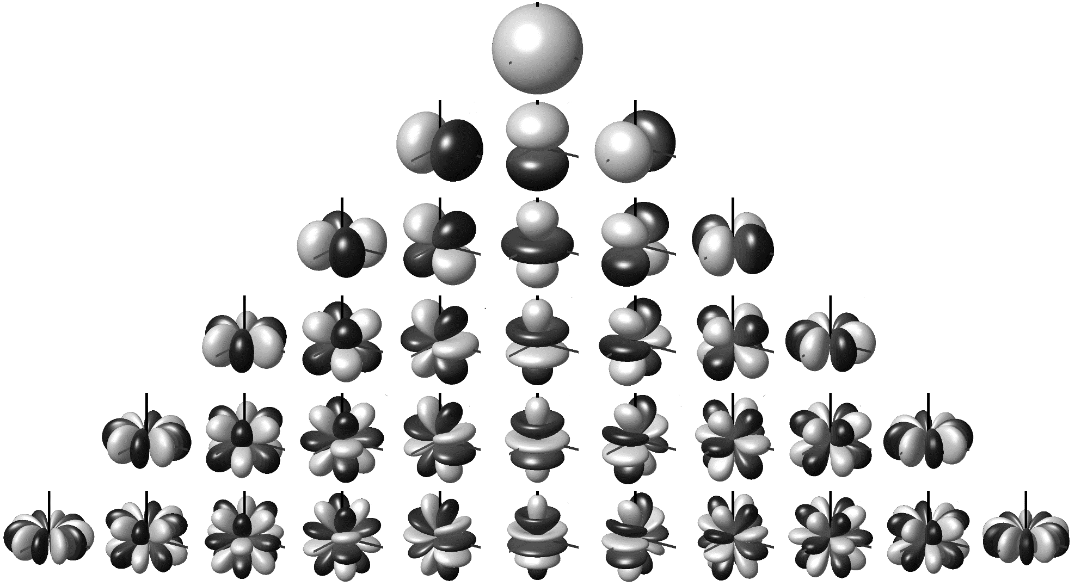
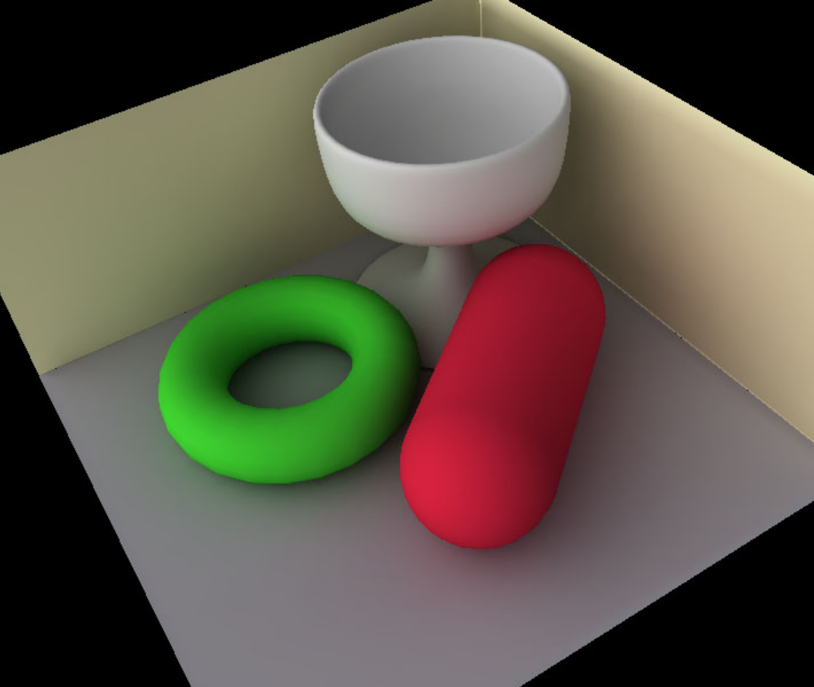
Precomputed Radiance Transfer
For instance:
$f_{\vec{ω_{o}}}\left(\vec{ω_{i}}\right) \left\langle \vec{ω_{i}}\right.,\left.\vec{n}\right\rangle = \sum_{k}{α_{k}}Y_{k}(\vec{ω_{i}})$
$L_{i}\left(\vec{ω_{i}}\right)=\sum_{k}{β_{k}}Y_{k}(\vec{ω_{i}})$
With $Y_{k}(\vec{ω_{i}})$ spherical harmonics

Slide 65
Precomputed Radiance Transfer
$Y_{k}\left(\vec{ω_{i}}\right)=α P_{l}^{m}\left(\cos{θ}\right)e^{imφ}$
With $P_{l}^{m}(x)$ the associated Legendre polynomial of order m (related to the m’th derivative of $P_{l}$
Eigenfunctions of the $Δ$ operator on the sphere
Equivalent to Fourier basis on the sphere
Fast computation via 2D Fast Fourier Transforms
The frequency content of the result is bounded by the minimum frequency content between the BRDF and illumination !
E.g. : a diffuse object under high frequency lighting looks the same as a metal ball under diffuse (constant) lighting
Other bases have been used: Spherical Wavelets, Zonal Harmonics, ...

Slide 66
Radiosity
Form factor:
$$G(x,x^{′})$$
$$L_{o}\left(x, \vec{ω_{o}}\right)=L_{e}\left(x,\vec{ω_{o}}\right)+\int_{P}{f\left(\vec{ω_{i}}, \vec{ω_{o}}\right)L_{i}\left(x,\vec{ω_{i}}\right)\left\langle \vec{ω_{i}}\right.,\left.\vec{n}\right\rangle \frac{V\left(x, x^{′}\right)\left|\left\langle \vec{ω_{i}}\right.,\left.\vec{n}′\right\rangle \right|}{{\left\|x−x^{′}\right\|}^{2}}dP}$$
Under diffuse reflectance, we have $f\left(\vec{ω_{i}}, \vec{ω_{o}}\right)=\frac{ρ}{π}$
And omnidirectional emissivity
So :
$$L_{o}(x)=L_{e}(x)+\frac{ρ(x)}{π}\int_{P}{L_{i}\left(x, \vec{ω_{i}}\right)G(x,x^{′})dP}$$

Slide 67
Radiosity
$$L_{o}(x)=L_{e}(x)+\frac{ρ(x)}{π}\int_{P}{L_{i}\left(x, \vec{ω_{i}}\right)G(x,x^{′})dP}$$
Now, discretizing and assuming constant values per triangle k:
$$L^{k}=L_{e}^{k}+\frac{ρ^{k}}{π}\sum_{l}{L^{l}}G^{k,l}$$
(could also take any basis function over triangles instead)

Slide 68
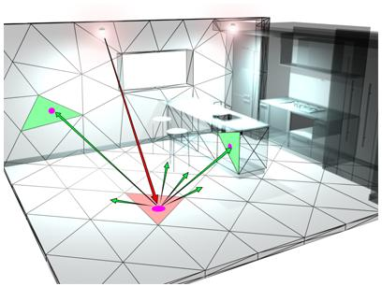
Radiosity
$$L^{k}=L_{e}^{k}+\frac{ρ^{k}}{π}\sum_{l}{L^{l}}G^{k,l}$$
Can be written in matrix form. Consider a vector L and matrix G :
$$L=L_{e}+diag\frac{ρ}{π} G L$$
Re-arranging terms:
$$L={\left(Id − diag\frac{ρ}{π} G\right)}^{−1}L_{e}$$ Can be solved numerically quite easily
$$M$$

Slide 69
Radiosity
Instead of a full direct linear solve, use Gauss-Seidel iterations
$$L_{i}=\frac{1}{M_{ii}}\left(L_{e}^{i} −\sum_{\begin{aligned}j=1 \\ j≠i\end{aligned}}^{n}{G^{ij}}L_{j}\right)$$
Each iteration corresponds to 1 light bounce:
One iteration:
$$∀i$$

Slide 70
Radiosity
Unfortunately, now mostly abandoned
Has been generalized to non-diffuse scenes
To (near) realtime settings*
But nice meshing is difficult
Conceptually simpler methods exist (e.g., photon maps)
* Implicit Visibility and Antiradiance for Interactive Global Illumination, Dachsbacher et al.

Slide 71
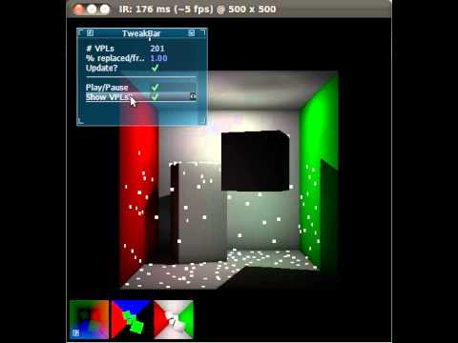
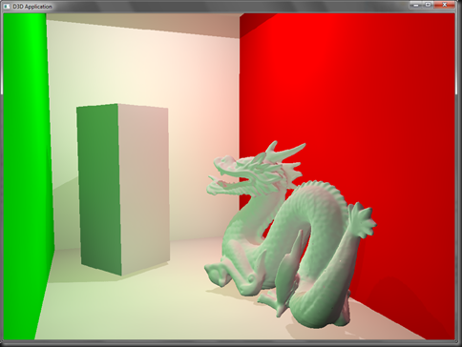
Physically-based rendering meets realtime
Instant radiosity
Essentially unrelated to radiosity, but more related to photon mapping
Sends “Virtual Point Lights” from light sources, use them as new light sources

Slide 72
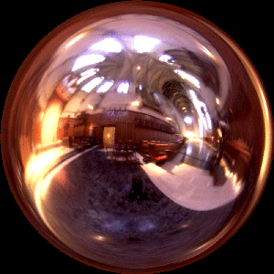
Prefiltered environment maps
$$L_{o}\left(x, \vec{ω_{o}}\right)=L_{e}\left(x,\vec{ω_{o}}\right)+\int_{Ω}{f\left(\vec{ω_{i}}, \vec{ω_{o}}\right)L_{i}\left(x,\vec{ω_{i}}\right)\left\langle \vec{ω_{i}}\right.,\left.\vec{n}\right\rangle d\vec{ω_{i}}}$$
When the incident illumination is distant:
Spherical convolution between $f\left(. ,\vec{ω_{o}}\right)\left\langle . \right.,\left.\vec{n}\right\rangle$and $L_{i}$
A Unified Approach to Prefiltered Environment Maps, Kautz et al.

Slide 73
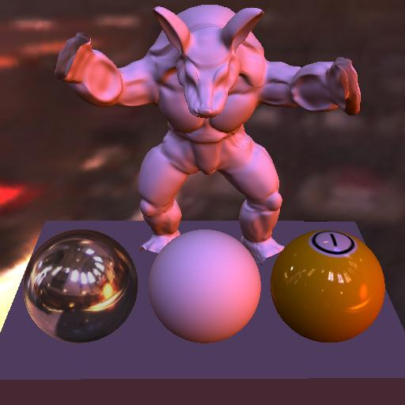
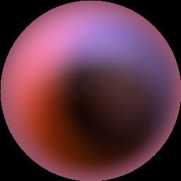
Prefiltered environment maps
Precomputing convolutions between environment map and BRDF for various $ω_{o}$
Easy for some BRDF : Gaussian blur
Just a lookup when rendering:

Slide 74
Image-based rendering
Further from physically-based rendering
Essentially interpolates between photographs
Lightfields / Lumigraph : dense array of photographs
Multi-view : sparse set
Restricted to real-life scenes
Depth Synthesis and Local Warps for Plausible Image-based Navigation, Chaurasia et al.

