Slide 1
Quality: for(;;) {test; specify; code}
Illustrated with the simple problem of
testing the equivalence of circular lists
September 2016, Pierre-Edouard Portier
http://liris.cnrs.fr/pierre-edouard.portier/teaching_2016_2017/

Slide 2
$$A\left(i:0≤i<N\right) \\ B\left(i:0≤i<N\right) \\ A.i=A.\left(i+N\right)$$

Slide 3
@Test
public void testSetGetModulo() {
CL a = new CL(3);
a.set(0, 7); a.set(4, 8); a.set(2, 9);
assertEquals(8,a.get(1));
}

Slide 4
@Invariant("s>=0")
public class CL {
/**
* s: size of the circular list (CL)
*/
public final int s;
/**
* a: array used to model a CL
*/
private int a[];
CL(int _size){
s = _size;
a = new int[s];
}

Slide 5
/**
* set the value of an element of the CL
*
* @param _i index in CL understood modulo the size of the CL
* @param _x value of the new element
*/
@Requires("_i >= 0")
public void set(int _i, int _x){
a[(_i%s)] = _x;
}

Slide 6
/**
* get a value from the CL
*
* @param _i index in CL understood modulo the size of the CL
* @return the value at index _i modulo the size of the CL
*/
@Requires("_i >= 0")
public int get(int _i){
return a[(_i%s)];
}

Slide 7
Set of rotations of A:
$$RA.i = A\left(k:i≤k<i+N\right) \\ RA.i =RA.\left(i+N\right) \\ \#RA ≤N$$

Slide 8
@Test
public void testRot() {
CL a = new CL(3);
a.set(0, 7); a.set(1, 8); a.set(2, 9);
int[] expected = {8, 9, 7};
assertArrayEquals(expected, a.rot(1));
}

Slide 9
/**
* rotate a CL by an offset of _i
*
* @param _i
* @return an array that represents the rotation of the CL
*/
@Requires("_i >= 0")
public int[] rot(int _i){
int[] res = new int[s];
for(int j=_i, k=0 ; j < (_i+s) ; j++, k++){
res[k] = get(j);
}
return res;
}

Slide 10
Postcondition:
$$R: res≡ \left(∃i,j∷RA.i=RB.j\right)$$

Slide 11
@Test
public void testRot_eq() {
CL a = new CL(3);
a.set(0,7); a.set(1,9); a.set(2,8);
CL b = new CL(3);
b.set(0,9); b.set(1,8); b.set(2,7);
assertTrue(CL.rot_eq(a, 0, b, 2));
}

Slide 12
/**
* @param _a CL
* @param _i offset used to rotate _a
* @param _b CL
* @param _j offset used to rotate _b
* @return Is the _ith-rotation of CL _a equals to the _jth-rotation of CL _b?
*/
@Requires({"_i >= 0", "_j >= 0"})
public static boolean rot_eq(CL _a, int _i, CL _b, int _j){
return Arrays.equals(_a.rot(_i), _b.rot(_j));
}

Slide 13
$$R: res≡ \left(∃i,j∷RA.i=RB.j\right)$$
Naïve solution:
Compare $A$ with each element of $RB$

Slide 14
@Test
public void testCL_eq() {
CL a = new CL(3);
a.set(0,7); a.set(1,9); a.set(2,8);
CL b = new CL(3);
b.set(0,9); b.set(1,8); b.set(2,7);
assertTrue(CL.eq(a, b));
}

Slide 15
/**
*
* @param _a a CL
* @param _b a CL
* @return Are the lexicographically sorted versions of a and b are equal?
*/
@Requires("_a.s == _b.s")
public static boolean eq(CL _a, CL _b) {
for(int i=0 ; i<_a.s ; i++){
if(Arrays.equals(_a.a, _b.rot(i))) return true;
}
return false;
}

Slide 16
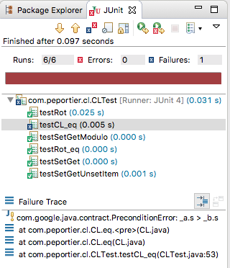
Example of a COFOJA error

Slide 17
The naïve solution doesn’t scale:
$$O\left(N^{2}\right)$$

Slide 18
@Test(timeout=30000)
public void testCL_eq_scale() {
int SIZE = 100000;
int[] a_vals = new int[SIZE];
for (int i = 0 ; i < SIZE ; i++) {
a_vals[i] = i;
}
CL a = new CL(SIZE, a_vals);
int[] b_vals = a.rot(SIZE/2);
CL b = new CL(SIZE, b_vals);
assertTrue(CL.eq(a, b));
}

Slide 19
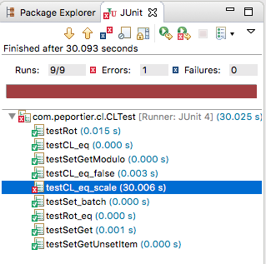

Slide 20
$RA$ and $RB$ are either disjoint or equal
$$\left(∀ k,i,j∷RA.i≡RB.j⇒RA.\left(i+k\right)=RB.\left(j+k\right)\right)$$

Slide 21
It is sufficient to compare canonical elements
$AA$: first element of $RA$ sorted lexicographically
$R$ can be solved by computing $AA$ and $BB$

Slide 22
To find the solution $res≡true$, we can:
(a) Find a pair $\left(i,j\right)$ such that $RA.i=RB.j$
To find the solution $res≡false$, we can:
(b) Observe $AA≠BB$

Slide 23
To find the solution $res≡true$, we can:
(a) Find a pair $\left(i,j\right)$ such that $RA.i=RB.j$
Weakening (a) into a loop invariant:
$$P: 0≤h ∧ \left(∀ k :0≤k<h :RA.i.k=RB.j.k\right)$$
$$P∧h≥N ⇒ true≡ \left(∃ i,j∷RA.i=RB.j\right)$$

Slide 24
@Test
public void testCL_inv_P() {
CL a = new CL(3);
a.set(0,7); a.set(1,9); a.set(2,8);
CL b = new CL(3);
b.set(0,9); b.set(1,8); b.set(2,7);
assertTrue(CL.inv_P(2, 0, 2, a, b));
}

Slide 25
@Requires({"_h >= 0", "_i >= 0", "_j >= 0"})
public static boolean inv_P(int _h, int _i, int _j, CL _a, CL _b) {
boolean res = true;
for (int k = 0 ; k < _h ; k++)
res &= _a.rot(_i)[k] == _b.rot(_j)[k];
return res;
}

Slide 26
To find the solution $res≡false$, we can:
(b) Observe $AA≠BB$
Weakening (b) into a loop invariant:
$$QA: 0≤i ∧ \left(∀ k :0≤k<i :RA.k>BB\right)$$
$$QA∧i≥N ⇒ false≡ \left(∃ i,j∷RA.i=RB.j\right)$$
Symmetrically for $QB$
The two CL differ if:
$$QA∧QB∧\left(i≥N ∨ j≥N\right)$$

Slide 27
@Test
public void testCL_inv_Q() {
CL a = new CL(3);
a.set(0,7); a.set(1,9); a.set(2,8);
CL b = new CL(3);
b.set(0,9); b.set(1,8); b.set(2,8);
assertTrue(CL.inv_Q(2, b, a));
}

Slide 28
@Test
public void testCL_smallest() {
CL a = new CL(3);
a.set(0,9); a.set(1,8); a.set(2,8);
int[] expected = {8, 8, 9};
assertArrayEquals(expected, a.smallest());
}

Slide 29
public int[] smallest() {
int aa[] = a.clone();
for (int k = 1 ; k < s ; k++) {
int rot_k[] = rot(k);
boolean new_smallest = false;
for (int i = 0 ; i < s ; i++) {
if (aa[i] == rot_k[i]) {
// do nothing
} else if (aa[i] > rot_k[i]) {
new_smallest = true; break;
} else if (aa[i] < rot_k[i]) {
new_smallest = false; break;
} else assert false;
}
if (new_smallest) aa = rot_k.clone();
}
return aa;
}

Slide 30
@Requires({"_i >= 0", "_a.s == _b.s"})
public static boolean inv_Q(int _i, CL _a, CL _b) {
boolean res = true;
int bb[] = _b.smallest();
for (int k = 0 ; k < _i ; k++) {
int rot_k_of_a[] = _a.rot(k);
for (int j = 0 ; j < _a.s ; j++) {
if (rot_k_of_a[j] == bb[j]) {
if (j == (_a.s - 1)) { res = false; break; }
} else {
if (rot_k_of_a[j] > bb[j]) {res &= true; break; }
else { res = false; break; }
}
}
if (res == false) break;
}
return res;
}

Slide 31
We have the sketch of a solution…

Slide 32
@Requires("_a.s == _b.s")
@Ensures("result == CL.eq(_a,_b)")
public static boolean eq2(CL _a, CL _b) {
boolean res = false;
int h,i,j;
h = i = j = 0;
assert CL.inv_P(h, i, j, _a, _b);
assert CL.inv_Q(i, _a, _b);
assert CL.inv_Q(j, _b, _a);
while (h<_a.s && i<_a.s && j<_a.s) {
assert (h+i+j) <= (3*_a.s - 3);
// increase h+i+j while maintaining P & QA & QB
}
assert CL.inv_P(h, i, j, _a, _b);
assert CL.inv_Q(i, _a, _b);
assert CL.inv_Q(j, _b, _a);
assert (h>=_a.s) || (i>=_a.s) || (j>=_a.s);
if (h >= _a.s) res = true;
else if (i>=_a.s || j>=_a.s) res = false;
return res;
}

Slide 33
$$P: 0≤h ∧ \left(∀ k :0≤k<h :RA.i.k=RB.j.k\right)$$
When $RA.i.h=RB.j.h$ (i.e., $A.\left(i+h\right)=B.\left(j+h\right)$):
$h←h+1$ will maintain $P$ and assure progress.

Slide 34
$$P: 0≤h ∧ \left(∀ k :0≤k<h :RA.i.k=RB.j.k\right)$$
$$QA: 0≤i ∧ \left(∀ k :0≤k<i :RA.k>BB\right)$$
$$RA.i.h>RB.j.h ∧ P$$
$⇒$ {def. P, $0≤p≤h$}
$$RA.i.h>RB.j.h ∧ \left(∀ k :p≤k<h :RA.i.k=RB.j.k\right)$$
$⇒$ {lexicographic ordering}
$$RA.\left(i+p\right)>RB.\left(j+p\right)$$
$⇒$ {def. BB}
$$RA.\left(i+p\right)>BB$$
$$QA ∧ P ∧ A.\left(i+h\right)>B.\left(j+h\right)$$
$⇒$ {see above}
$$QA ∧ \left(∀ p :0≤p≤h :RA.\left(i+p\right)>BB\right)$$
$=$ {renaming the bounded variable: $i+p=k$}
$$QA ∧ \left(∀ k :i≤k≤i+h :RA.k>BB\right)$$
$=$ {def. $QA$}
$$QA\left[i\backslash i+h+1\right]$$

Slide 35
int progress;
while (h<_a.s && i<_a.s && j<_a.s) {
assert (h+i+j) <= (3*_a.s - 3);
progress = h+i+j;
// increase h+i+j while maintaining P & QA & QB
if (_a.get(i+h) == _b.get(j+h)) h = h+1;
else if (_a.get(i+h) > _b.get(j+h)) {i = i+h+1; h=0;}
else if (_b.get(j+h) > _a.get(i+h)) {j = j+h+1; h=0;}
else assert false;
assert CL.inv_P(h, i, j, _a, _b);
assert CL.inv_Q(i, _a, _b);
assert CL.inv_Q(j, _b, _a);
assert h+i+j > progress;
}

Slide 36
@Test(timeout=60000)
public void testCL_eq2_scale() {
int SIZE = 100000;
int[] a_vals = new int[SIZE];
for (int i = 0 ; i < SIZE ; i++) {
a_vals[i] = i;
}
CL a = new CL(SIZE, a_vals);
int[] b_vals = a.rot(SIZE/2);
CL b = new CL(SIZE, b_vals);
assertTrue(CL.eq2(a, b));
}

Slide 37
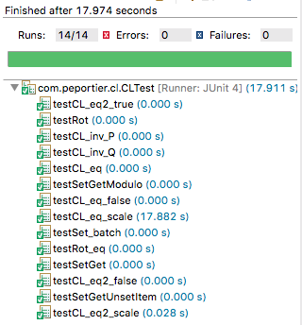

Slide 38
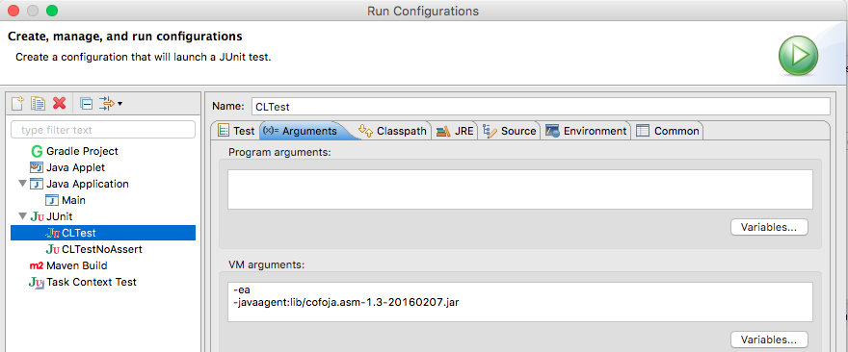

Slide 39
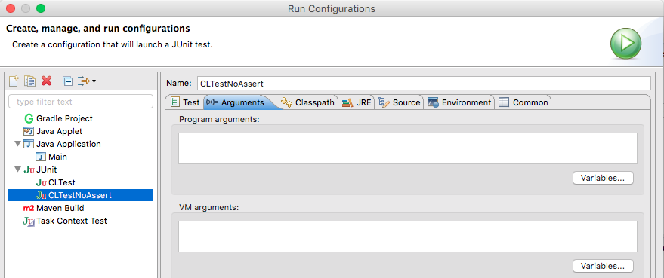

Slide 40
http://www.eclemma.org/

Slide 41
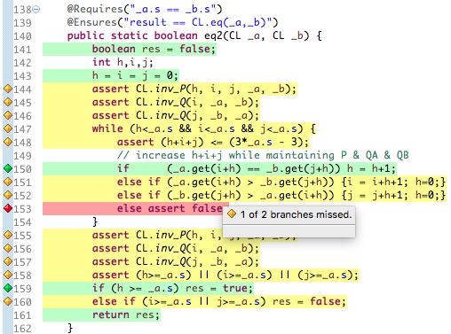

Slide 42
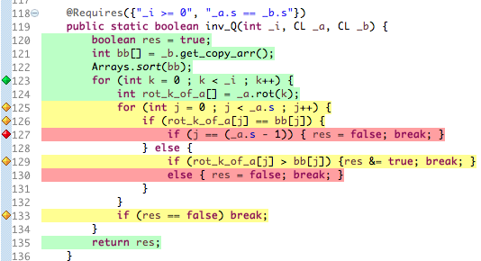

Slide 43
Shiloach, Yossi.
"A fast equivalence-checking algorithm for circular lists.”
Information Processing Letters 8.5 (1979): 236-238.
Gasteren, Antonetta JM.
“On the shape of mathematical arguments. “
Vol. 445. Springer Science & Business Media, 1990.
https://en.wikipedia.org/wiki/Lexicographically_minimal_string_rotation

Slide 44
Links
http://docs.oracle.com/javase/6/docs/technotes/guides/language/assert.html#usage-conditions
https://github.com/nhatminhle/cofoja
https://www.eiffel.com/values/design-by-contract/
https://github.com/junit-team/junit4/wiki/Assertions
http://www.vogella.com/tutorials/JUnit/article.html#using-junit-integrated-into-eclipse

